Slide 1


Dany A. DARGHOUTH
September 2023

Slide 2

Outline
Executive Summary
Introduction
Methodology
Results
Conclusion
Appendix

Slide 3
Executive Summary
Summary of methodologies
Quantitative and Qualitative analysis of data scraped form available data thanks to the SpaceX API
Machine Learning Methods for prediction
Summary of all results
Support Vector Machines and KNN are best suited for the predictions
Predictions accuracy of 78%

Slide 4
Introduction
Project background and context
SpaceY a new Rocket Company founded by Allon Musk, wishes to compete with SpaceX.
Problems you want to find answers
In order to have a better understanding of the competition, the goal of this project is to be able to predic t the cost of a given SpaceX launch aswell as the probability of the company re—using the first stage of the launched rocket.

Slide 5

Section 1

Slide 6
Methodology
Executive Summary
Data collection methodology:
Data was scrapped form the available SpaceX API
Perform data wrangling
The retrieved data was then cleaned up, nulls quantitative values were replaced with the mean and categorical null values were kept.
Perform exploratory data analysis (EDA) using visualization and SQL
Perform interactive visual analytics using Folium and Plotly Dash
Perform predictive analysis using classification models
The data set was split into training and test data, various model were then trained and tested.

Slide 7
Data Collection
Describe how data sets were collected.
You need to present your data collection process use key phrases and flowcharts

Slide 8
Data Collection – SpaceX API
Github:
https://github.com/Dany-Drgh/ibm-data_science/blob/main/Capstone%20course/Week%201/Data%20Collection%20API.ipynb
Space X Wiki
Request & scrap the data from site using Beautiful Soup
Structure data to only include relevant data for analysis

Slide 9
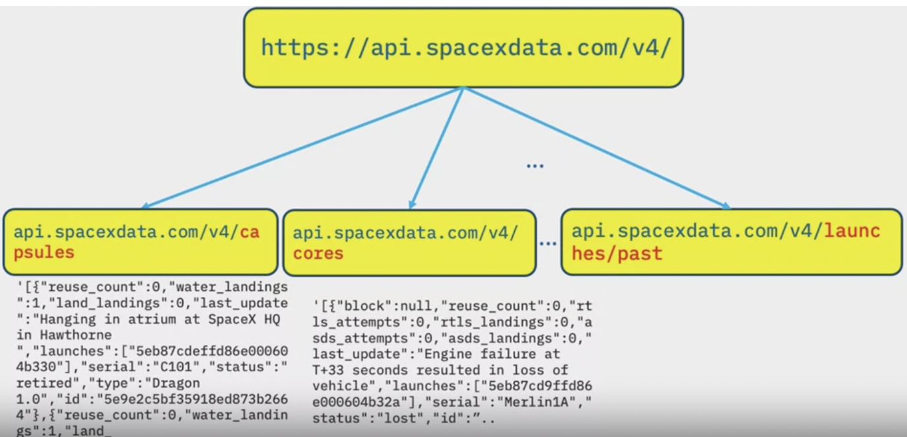
Data Collection - Scraping
Collected the data on falcon 9 launches straight from the site
Github link:
https://github.com/Dany-Drgh/ibm-data_science/blob/main/Capstone%20course/Week%201/Data%20Collection%20API.ipynb

Slide 10
EDA with Data Visualization
Variety of Charts Plotted
Flight No vs Payload Mass
Flight Number vs Launch Site
Payload Mass vs Launch Site
Orbit vs Class
Flight Number vs Orbit
PayloadMass vs Orbit
Data vs Class
Github (Both EDA notebooks)
https://github.com/Dany-Drgh/ibm-data_science/tree/main/Capstone%20course/Week%202

Slide 11
EDA with SQL
%sql SELECT Launch_Site FROM SPACEXTBL WHERE Launch_Site LIKE ‘%CCA%'
%sql SELECT SUM(PAYLOAD_MASS__KG_) from SPACEXTBL
%sql SELECT AVG(PAYLOAD_MASS__KG_) from SPACEXTBL WHERE Booster_Version = 'F9 v1.1’
%sql SELECT MIN(Landing_Outcome), Date FROM SPACEXTBL
%sql SELECT Booster_Version FROM SPACEXTBL Where Mission_Outcome = 'Success' AND PAYLOAD_MASS__KG_ between 4000 and 6000
%sql SELECT COUNT(*) FROM SPACEXTBL where Mission_Outcome LIKE '%Success%'
%sql SELECT * FROM SPACEXTBL WHERE PAYLOAD_MASS__KG_ > (SELECT AVG(PAYLOAD_MASS__KG_) FROM SPACEXTBL);
%sql SELECT substr(Date, 4, 2) as MONTH, Landing_Outcome, Booster_Version, Launch_Site FROM SPACEXTBL where Landing_Outcome like '%Failure (D%'
%sql SELECT COUNT(Landing_Outcome) from SPACEXTBL where Date Between '04-06-2010' and '20-03-2017' GROUP BY Landing_Outcome LIKE '%SUCCESS%' ORDER BY Landing_Outcome

Slide 12
Build an Interactive Map with Folium
Marked all launch sites on map
Marked all successful/failed launches for each site on the map
Calculated the distances between a launch site to its proximities
Added markers around the launch sites because it gives a good ideal of where and why the launches were done here
Clustered the markers based off whether or not the launch was successful also gave great data insights
This made it easy to identify which launch sites have relatively high success rates
https://github.com/Dany-Drgh/ibm-data_science/tree/main/Capstone%20course/Week%203

Slide 13
Build a Dashboard with Plotly Dash
In the dashboard, we are looking at the various types of launches and their success and failure rates.
There are 3 different launch sites we explore
Github :
https://github.com/Dany-Drgh/ibm-data_science/blob/main/Capstone%20course/Week%203/spacex_dash_app.py

Slide 14
Predictive Analysis (Classification)
Built a classification model using various supervised machine learning classification algorithms
Most efficient ones appear to be KNN and SVM
Github:
https://github.com/Dany-Drgh/ibm-data_science/blob/main/Capstone%20course/Week%204/SpaceX_Machine_Learning_Prediction_Part_5.jupyterlite.ipynb

Slide 15

Section 2

Slide 16
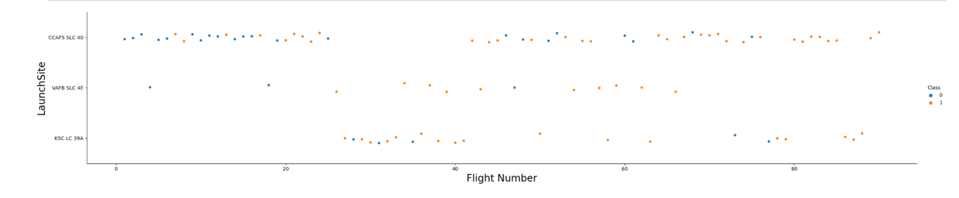
Flight Number vs. Launch Site
Launches are done in clusters

Slide 17
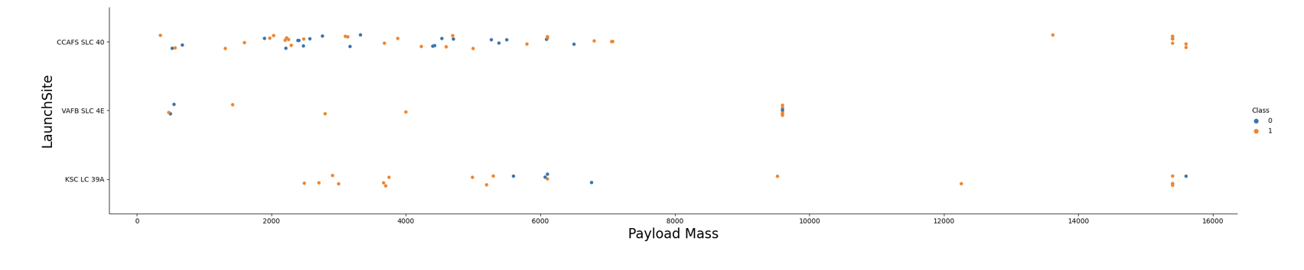
Payload vs. Launch Site
The higher the payload Mass, the more success the landing.
A lot of the landings were successful KSC LC 39A when the payload mass was less than 6000

Slide 18
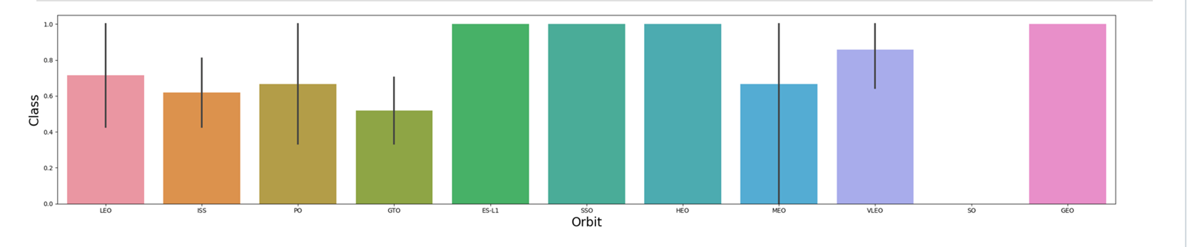
Success Rate vs. Orbit Type
ES-L1, SSO and HEO has a perfect success rate

Slide 19
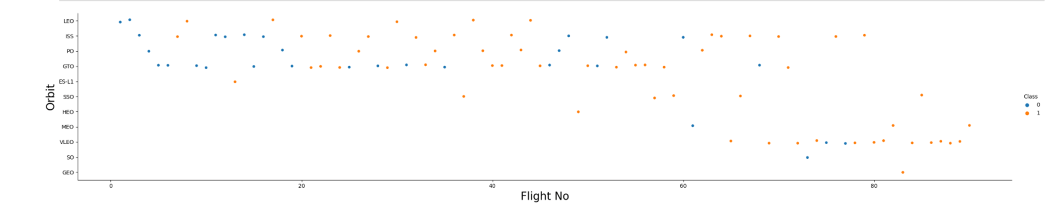
Flight Number vs. Orbit Type
Flight numbers over 80 typically have a succesful launch

Slide 20
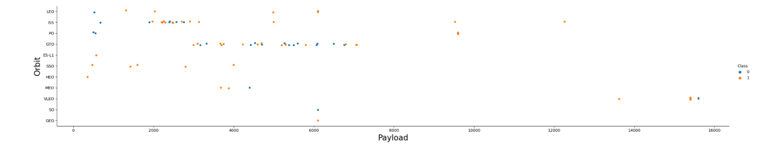
Payload vs. Orbit Type
Heavy payloads have more successful landings for Polar, LEO and ISS

Slide 21
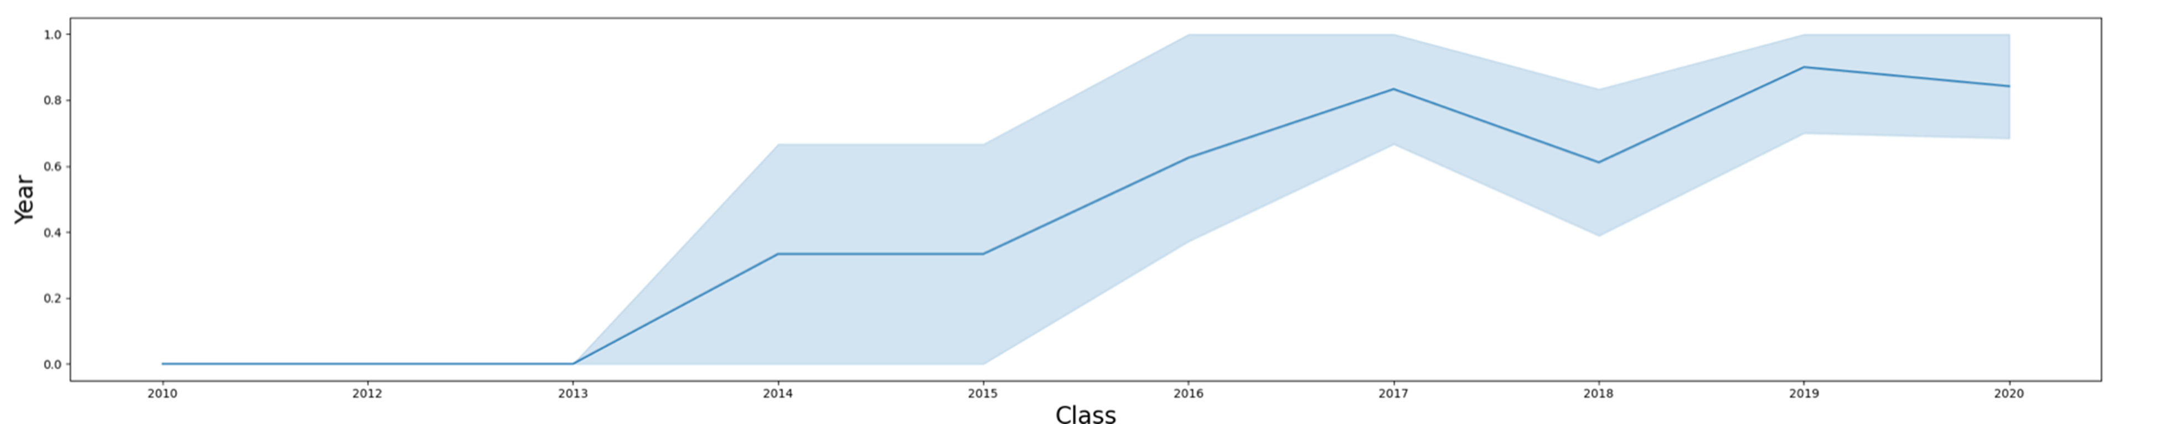
Launch Success Yearly Trend
Success rate was on a steady increase until 2017
Then it dipped slightly in 2018, to begin increasing again

Slide 22
All Launch Site Names
CCAFS LC-40
VAFB SLC-4E
KSC LC-39A
CCAFS SLC-40

Slide 23
Launch Site Names Begin with 'CCA'
Date | Time (UTC) | Booster_Version | Launch_Site | Payload | PAYLOAD_MASS__KG_ | Orbit | Customer | Mission_Outcome | Landing_Outcome
2010-04-06 | 18:45:00 | F9 v1.0 B0003 | CCAFS LC-40 | Dragon Spacecraft Qualification Unit | 0 | LEO | SpaceX | Success | Failure (parachute)
2010-08-12 | 15:43:00 | F9 v1.0 B0004 | CCAFS LC-40 | Dragon demo flight C1, two CubeSats, barrel of Brouere cheese | 0 | LEO (ISS) | NASA (COTS) NRO | Success | Failure (parachute)
2012-05-22 | 07:44:00 | F9 v1.0 B0005 | CCAFS LC-40 | Dragon demo flight C2 | 525 | LEO (ISS) | NASA (COTS) | Success | No attempt
2012-08-10 | 00:35:00 | F9 v1.0 B0006 | CCAFS LC-40 | SpaceX CRS-1 | 500 | LEO (ISS) | NASA (CRS) | Success | No attempt
2013-01-03 | 15:10:00 | F9 v1.0 B0007 | CCAFS LC-40 | SpaceX CRS-2 | 677 | LEO (ISS) | NASA (CRS) | Success | No attempt

Slide 24
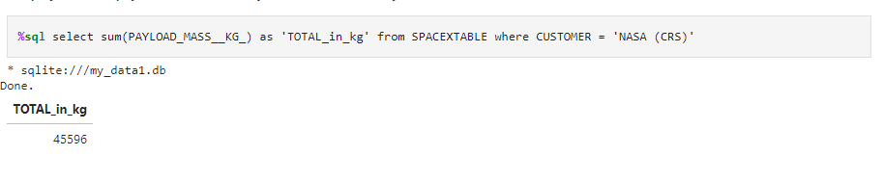
Total Payload Mass

Slide 25
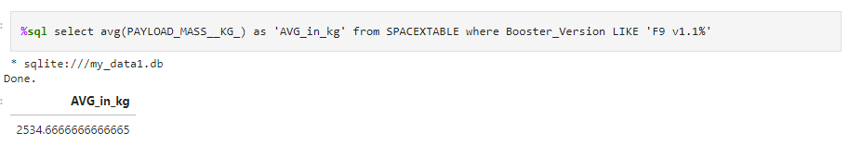
Average Payload Mass by F9 v1.1

Slide 26
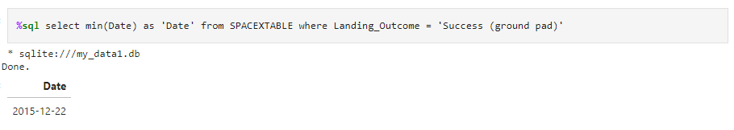
First Successful Ground Landing Date

Slide 27
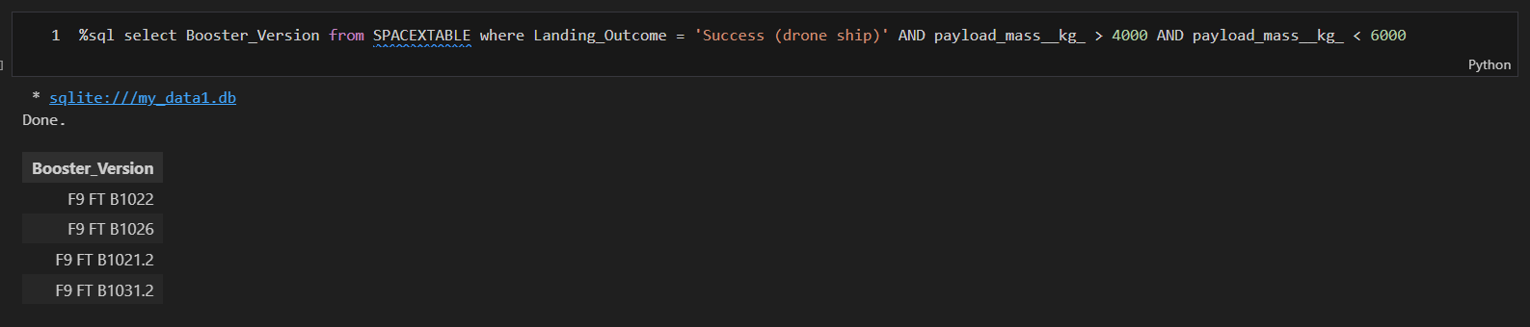
Successful Drone Ship Landing with Payload between 4000 and 6000

Slide 28
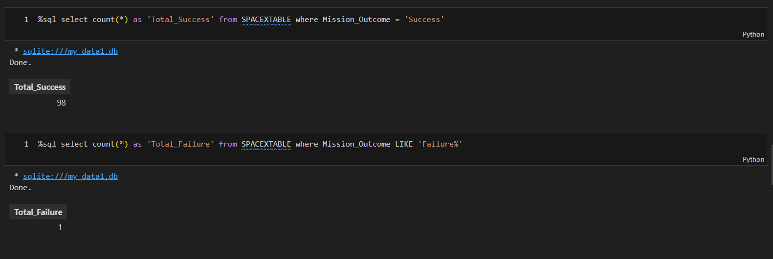
Total Number of Successful and Failure Mission Outcomes

Slide 29
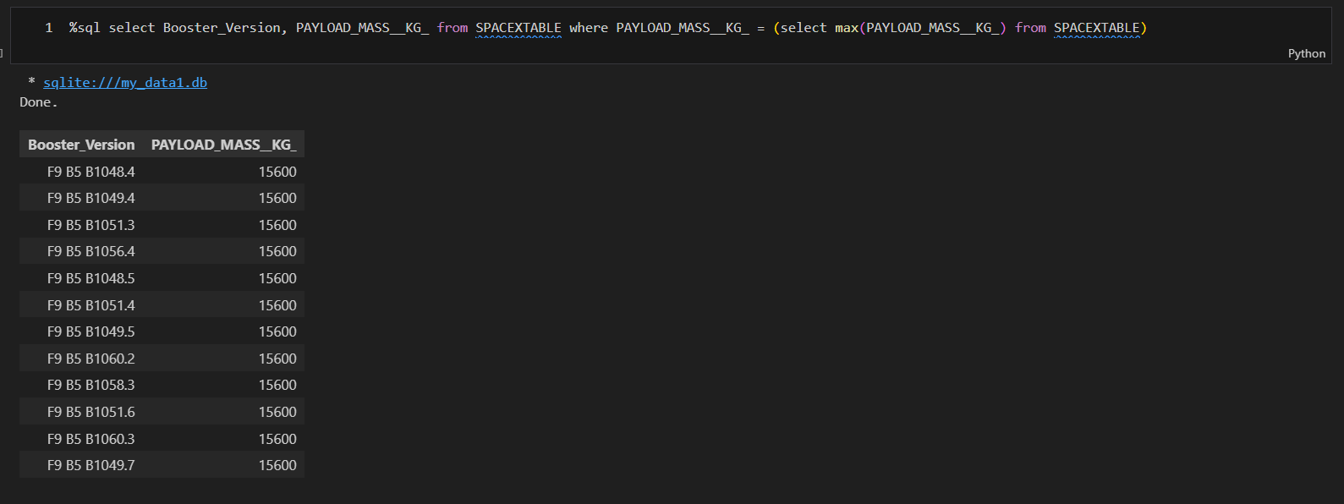
Boosters Carried Maximum Payload

Slide 30
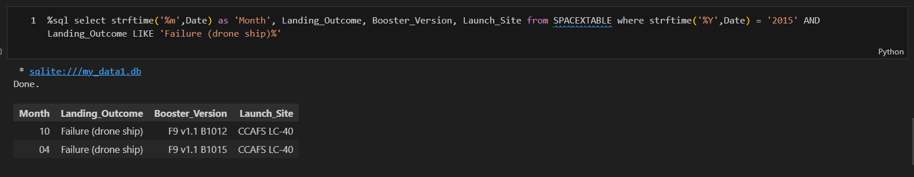
2015 Launch Records

Slide 31
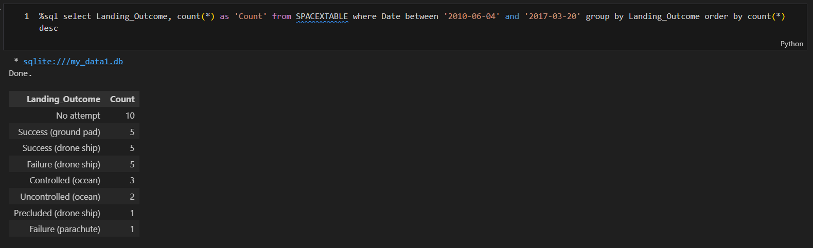
Rank Landing Outcomes Between 2010-06-04 and 2017-03-20

Slide 32

Section 3

Slide 33
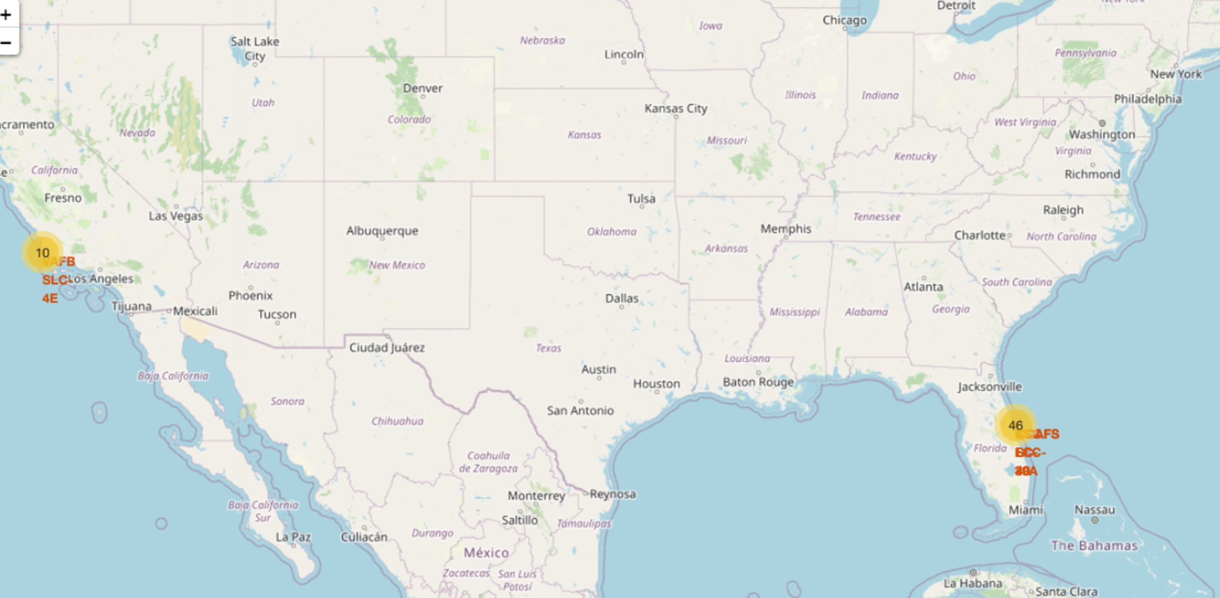
Launch Sites
Launch sites are by the ocean

Slide 34
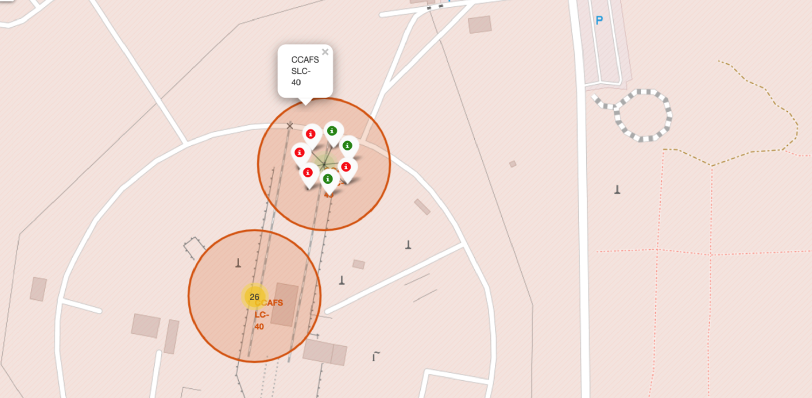
Launch Site CCFS SLC-40
Red = landing unsuccessful
Green = successful landing

Slide 35
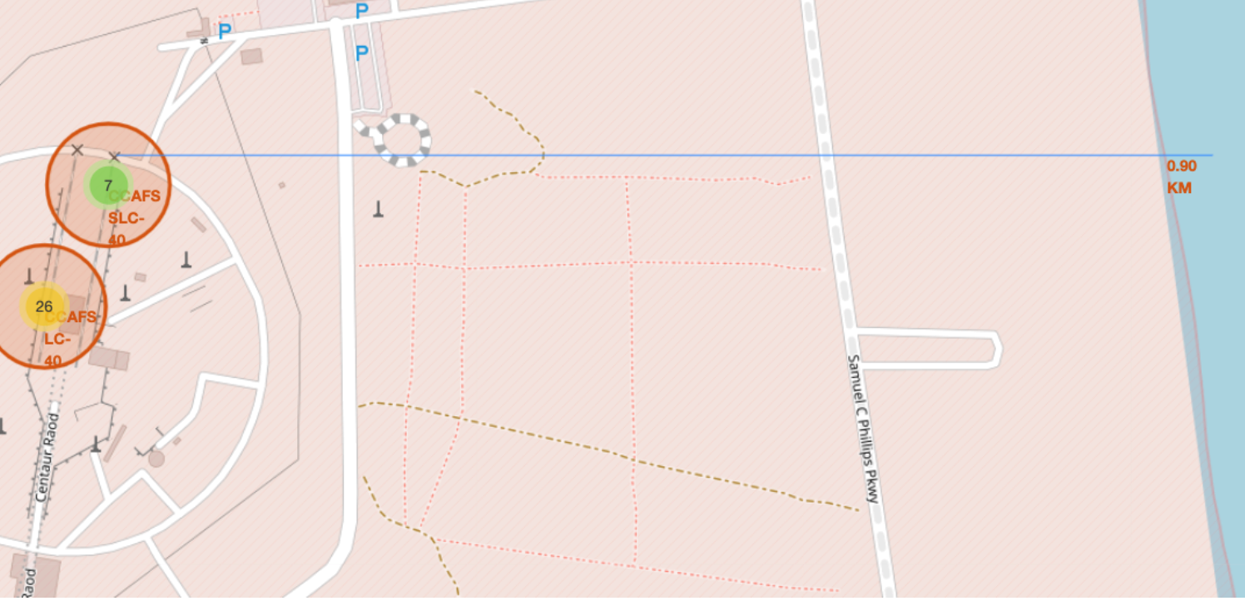
AFS Launch Sites
There are 7 landings in AFS SLC- 40
There are 26 landings at AFSLC - 40

Slide 36

Section 4

Slide 37
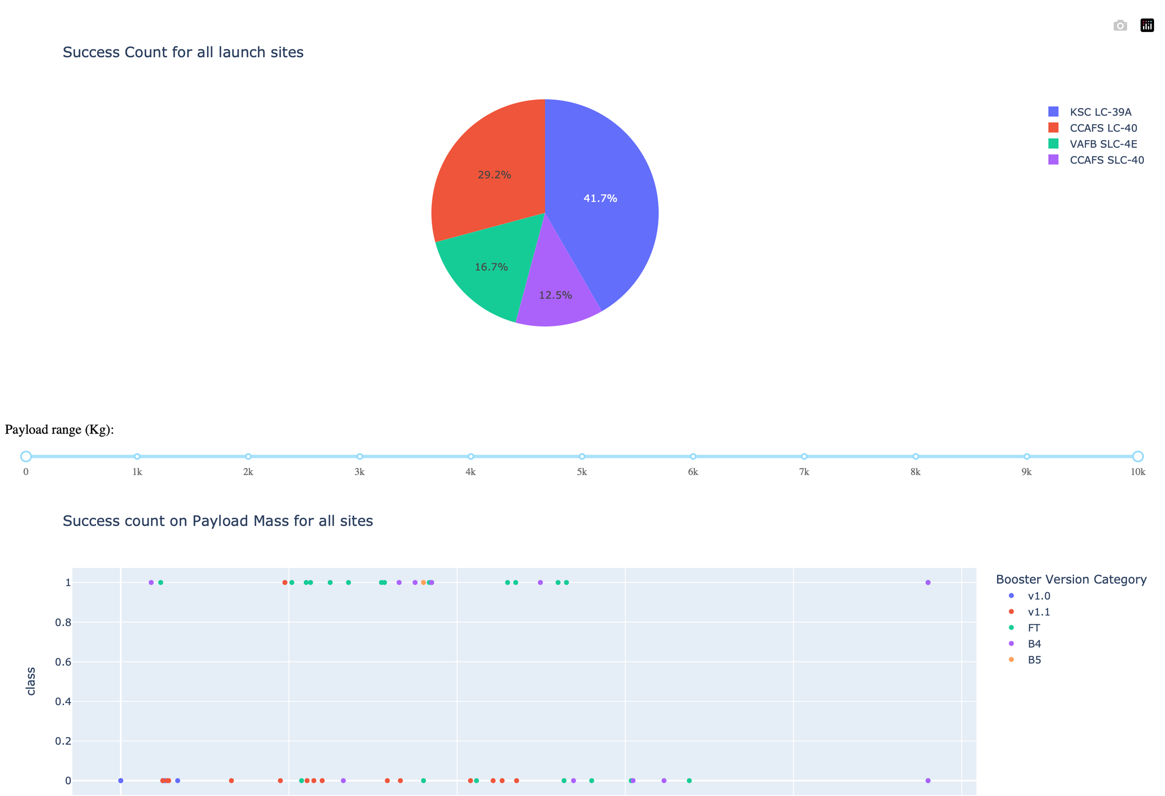
Dashboard

Slide 38

Section 5

Slide 39
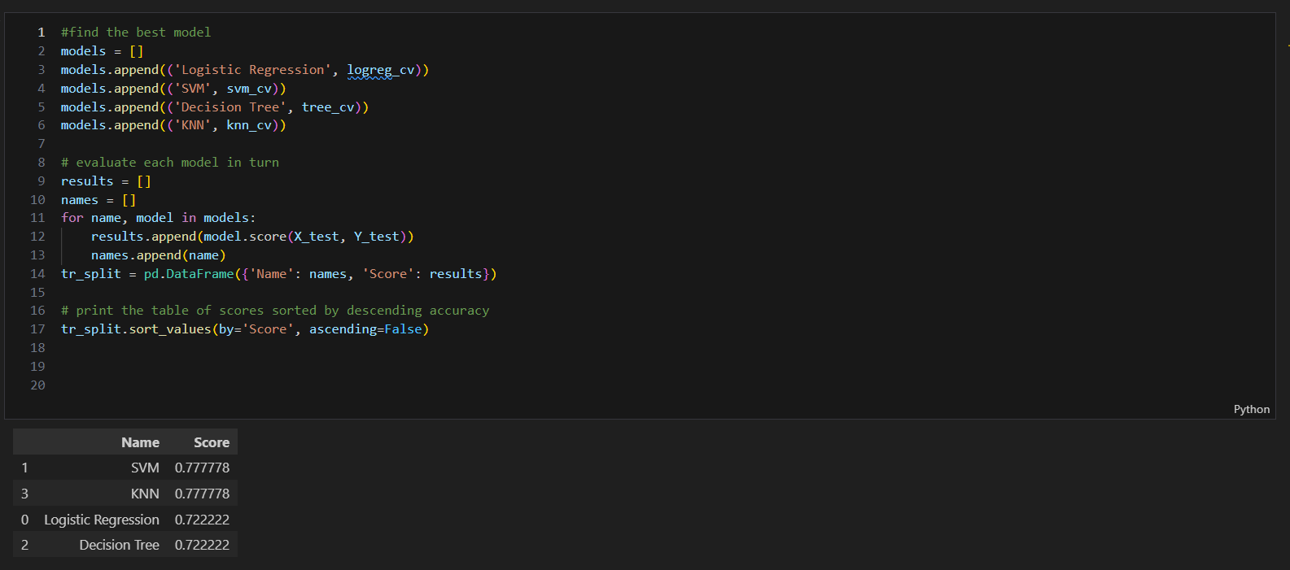
Classification Accuracy
Svm is the most Accurate Model

Slide 40
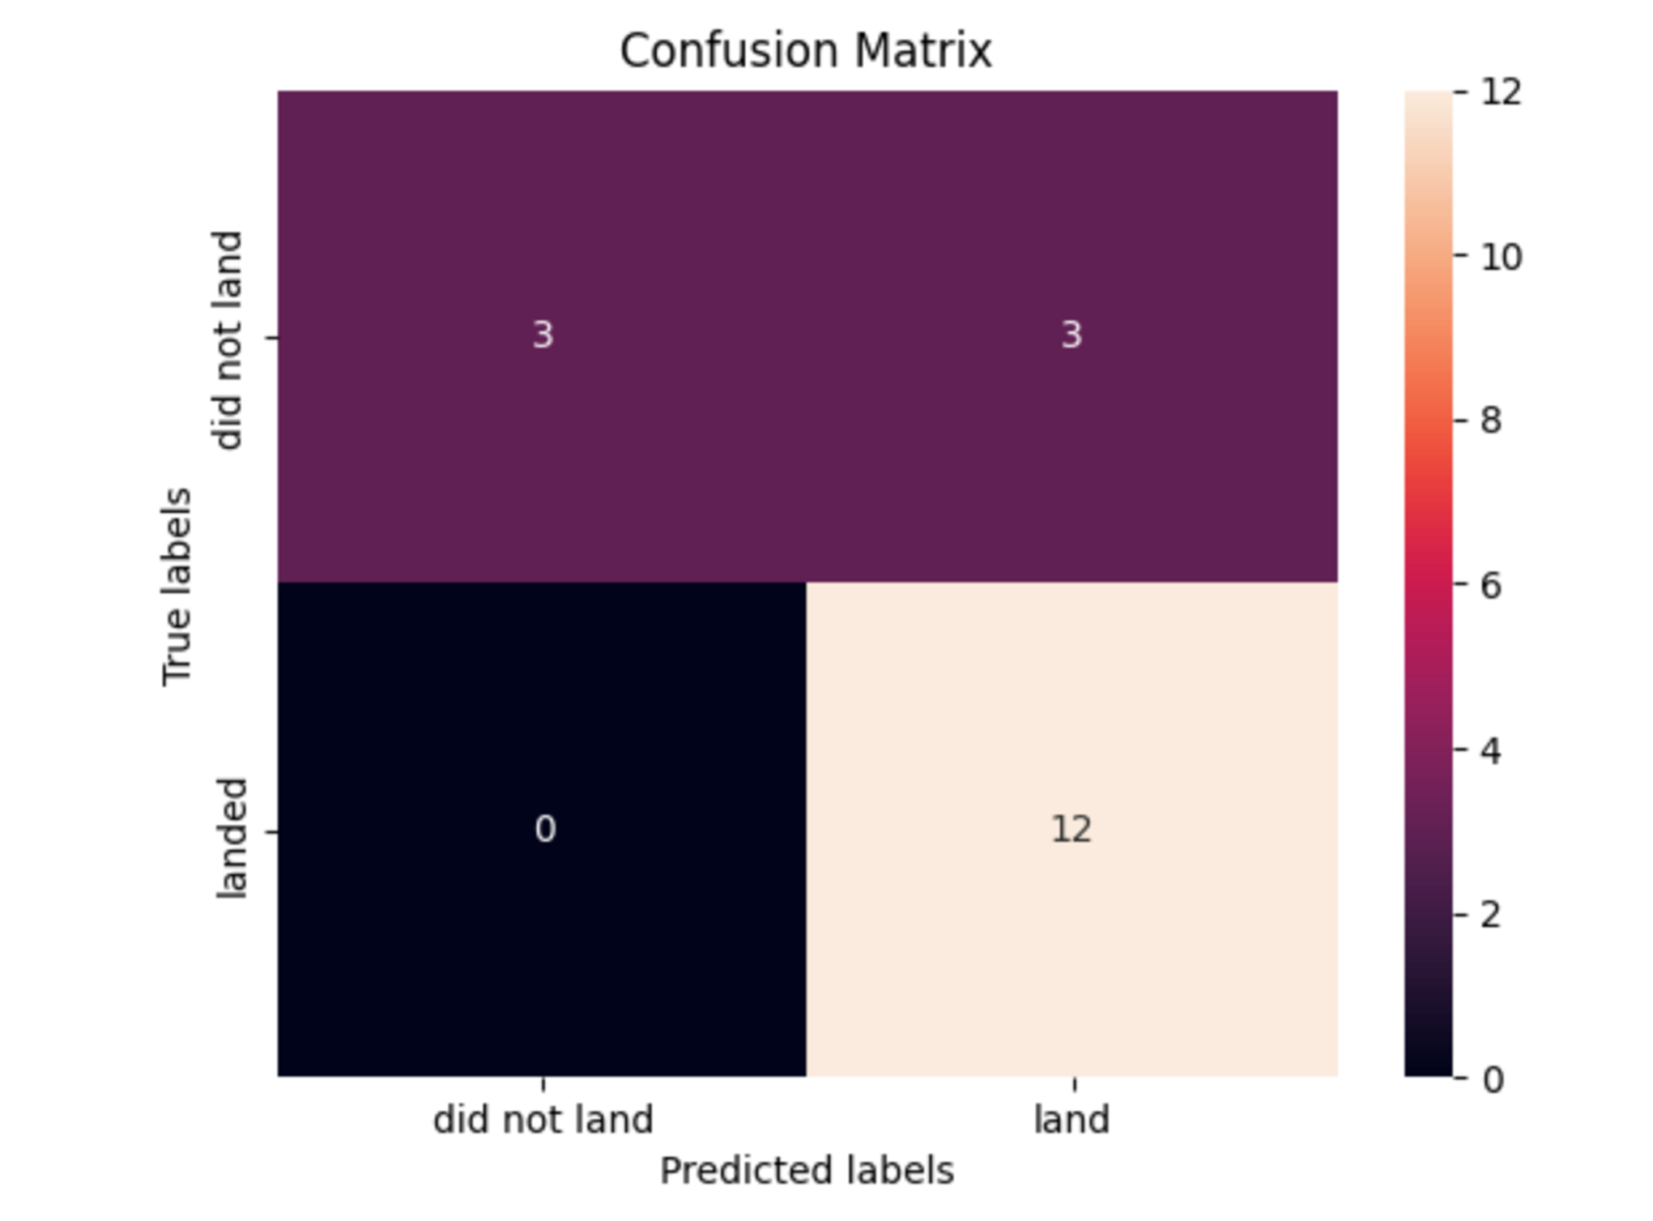
Confusion Matrix
The only issue here is a small proportion of false positives, it is however the smallest one amongst all models

Slide 41
Conclusions
Landing site KSC-LC 39A has the most successful landings
The SVM model is the best for predicting whether or not a spacecraft will land successfully or not
Its best to do the positive landings closer to land, so that they are more easily reusable.

Slide 42


